Slide 1
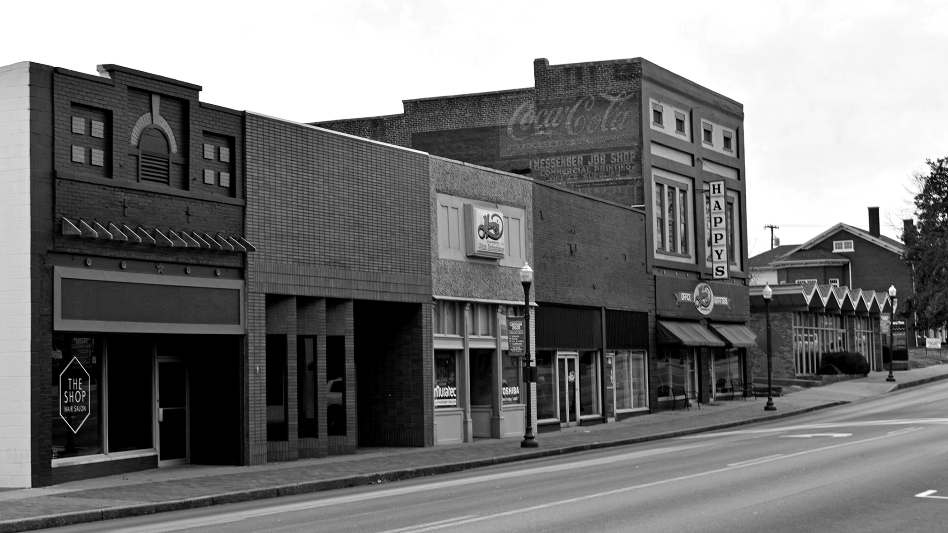
Believe in Hopkins County.
Belong to the Chamber.

Slide 2
Believe in Hopkins County. Belong to the Chamber.

Slide 3
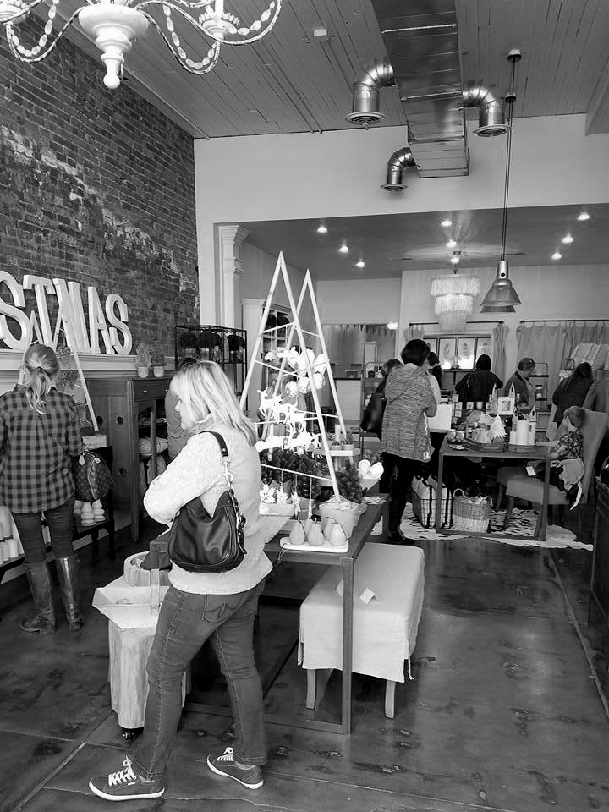
Imagine…
….how our community would be transformed if our local retail community generated $125,000 in economic impact for our region – IN A SINGLE WEEKEND.
Believe in Hopkins County. Belong to the Chamber.

Slide 4
How the Retail Industry Impacts Us All
Money spent at small businesses stays in OUR economy at a higher percentage than money spent at chain retailers.
1
Small businesses contribute to local job creation. Small businesses make up a huge portion of Hopkins County’s economy.
2
Shopping locally supports the small businesses that are the fabric of any community and contribute to the development of a unique, vibrant local culture.
3
Believe in Hopkins County. Belong to the Chamber.

Slide 5
OUR VISION
OUR MISSION
To be the catalyst for business growth to create a vibrant and prosperous community.
To promote business and commerce in Hopkins County.
Believe in Hopkins County. Belong to the Chamber.

Slide 6
Retain,
Expand,
Recruit
Retail Business
Believe in Hopkins County. Belong to the Chamber.

Slide 7
SHINING A SPOTLIGHT ON RETAIL
Total Market Supply
Total Market Supply
$419,336,802
This represents the amount captured by businesses located in the defined trade area. By block group the areas with darker green captured more dollars than the gray areas.
Believe in Hopkins County. Belong to the Chamber.

Slide 8
SHINING A SPOTLIGHT ON RETAIL
Total Market Demand
Total Market Demand
$689,634,310
This represents the amount spent by consumers located in the defined trade area. By block group the areas with darker green captured more dollars than the gray areas.
Believe in Hopkins County. Belong to the Chamber.

Slide 9
SHINING A SPOTLIGHT ON RETAIL
The Opportunity Gap
Total Market Leakage of
$270,297,508
This means more people purchase items outside of the defined trade area than in the defined trade area for their consumer goods and services. Dark gray shows block groups of retail synergy capturing those dollars. This is where our focus will be to place new retailers and restaurants.
Believe in Hopkins County. Belong to the Chamber.

Slide 10
SHINING A SPOTLIGHT ON RETAIL
Leakage
Food and Beverage Stores
$41,719,779
Building Material and Garden Equipment Stores
$24,890,814
Foodservice and Drinking Places
$24,035,008
Health & Personal Care Stores
$23,554,647
Sporting Goods, Hobby, Book, Music Stores
$8,528,394
Electronics & Appliance Stores
$7,334,615
Believe in Hopkins County. Belong to the Chamber.

Slide 11
Together, We Can!
Believe in Hopkins County. Belong to the Chamber.

Slide 12
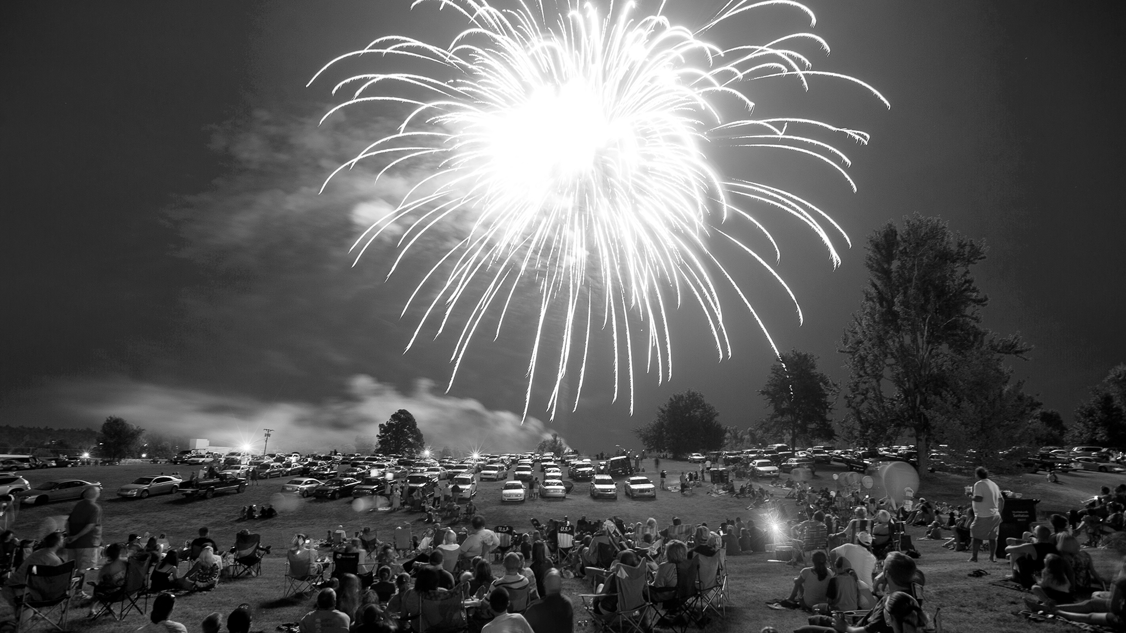
WHO WE ARE
WHY WE DO IT
We are a community of businesses working together to advance a vibrant economy.
When businesses thrive, communities flourish.
Believe in Hopkins County. Belong to the Chamber.

Slide 13
Our Culture
Servant Leadership We focus on members’ needs and the community we serve.
Integrity We are guided by our values and high ethical standards.
Collaboration We achieve more together.
Inclusiveness We welcome and respect everyone.
Innovation We think big and question the status quo.
At the Hopkins County Regional Chamber of Commerce, we are passionate about what we do and how we do it. We take our values seriously and they are part of who we are. It’s not enough to have vision and purpose. How we do business matters most. Our leadership community, membership, and staff developed these values and how we define them. These are the standards by which we work and engage our members and community.

Slide 14
Why Join?
NETWORKING
A VOICE FOR YOU
LEADERSHIP
BUILD COMMUNITY
There’s a seat at the table for you at the the Hopkins County Regional Chamber of Commerce. Join today to take advantage of these key benefits:
VISIBILITY
DISCOUNTS
DRIVE GROWTH
CREDIBILITY
Believe in Hopkins County. Belong to the Chamber.

Slide 15
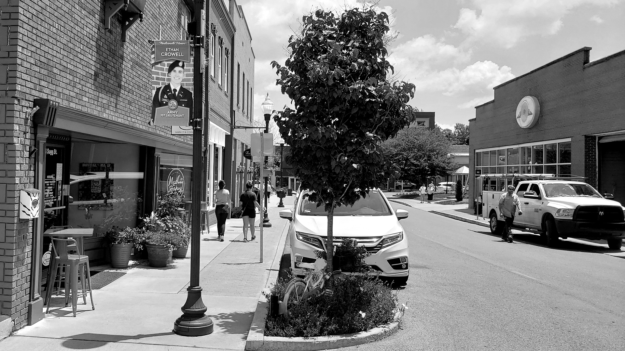
Join us.
Believe in Hopkins County.
Belong to the Chamber.
HopkinsChamber.com

